Slide 1
UNIT-II-Divide and Conquer
Max-Min Problem
Topological Sorting
Material prepared by Dr. N. Subhash Chandra
From Web resources, Computer Algorithms , Horowitz, Sahni & Rajasekaran

Slide 2
Max-Min Problem
Problem: Analyze the algorithm to find the maximum and minimum element from an array.
TWO METHODS:
Method 1 Straight forward: if we apply the general approach to the array of size n, the number of comparisons required are 2n-2.
Method-2: Divide and Conquer approach: we will divide the problem into sub-problems and find the max and min of each group, now max of each group will compare with the only max of another group and min with min.

Slide 3
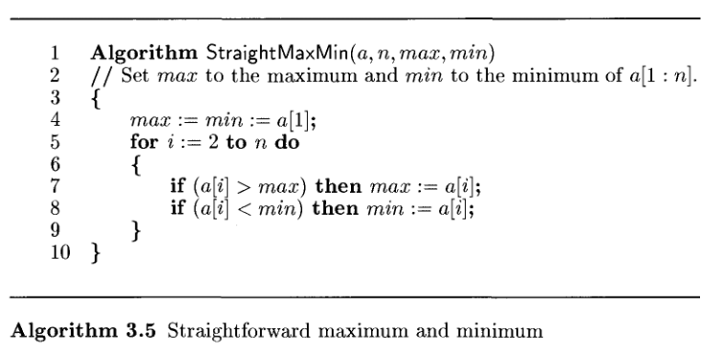
Straight forward Method: Max Min Problem

Slide 4
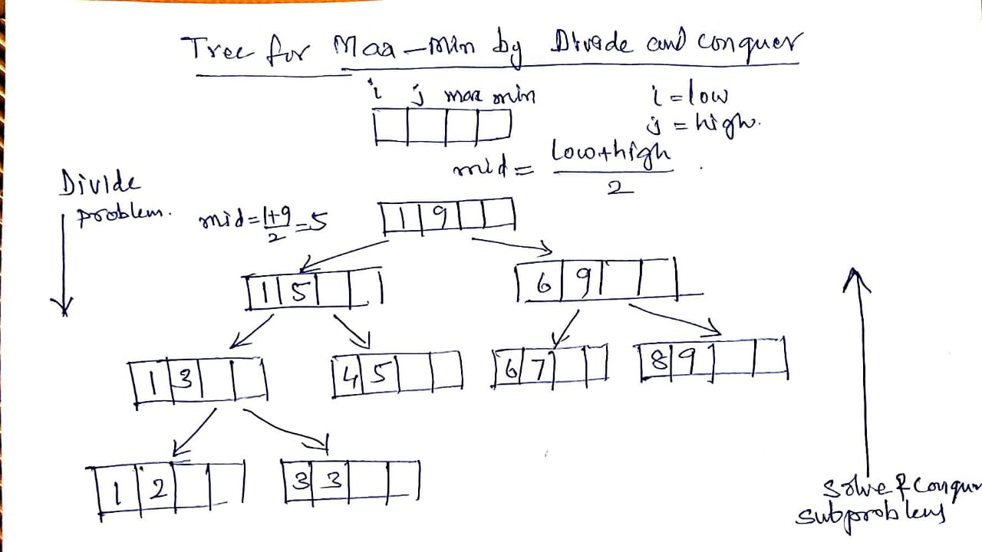
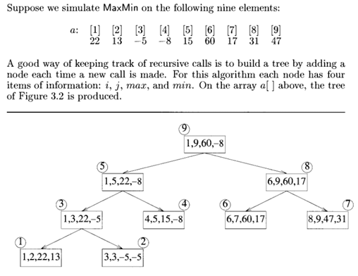
Max Min Problem: Divide and Conquer method
Exercise problems: Construct Max-Min tree for
25,13,8,50,98,-2,-17,45,55,88,97,5,-5
78,-2,98,14,78,-10,67,45,39,100

Slide 5
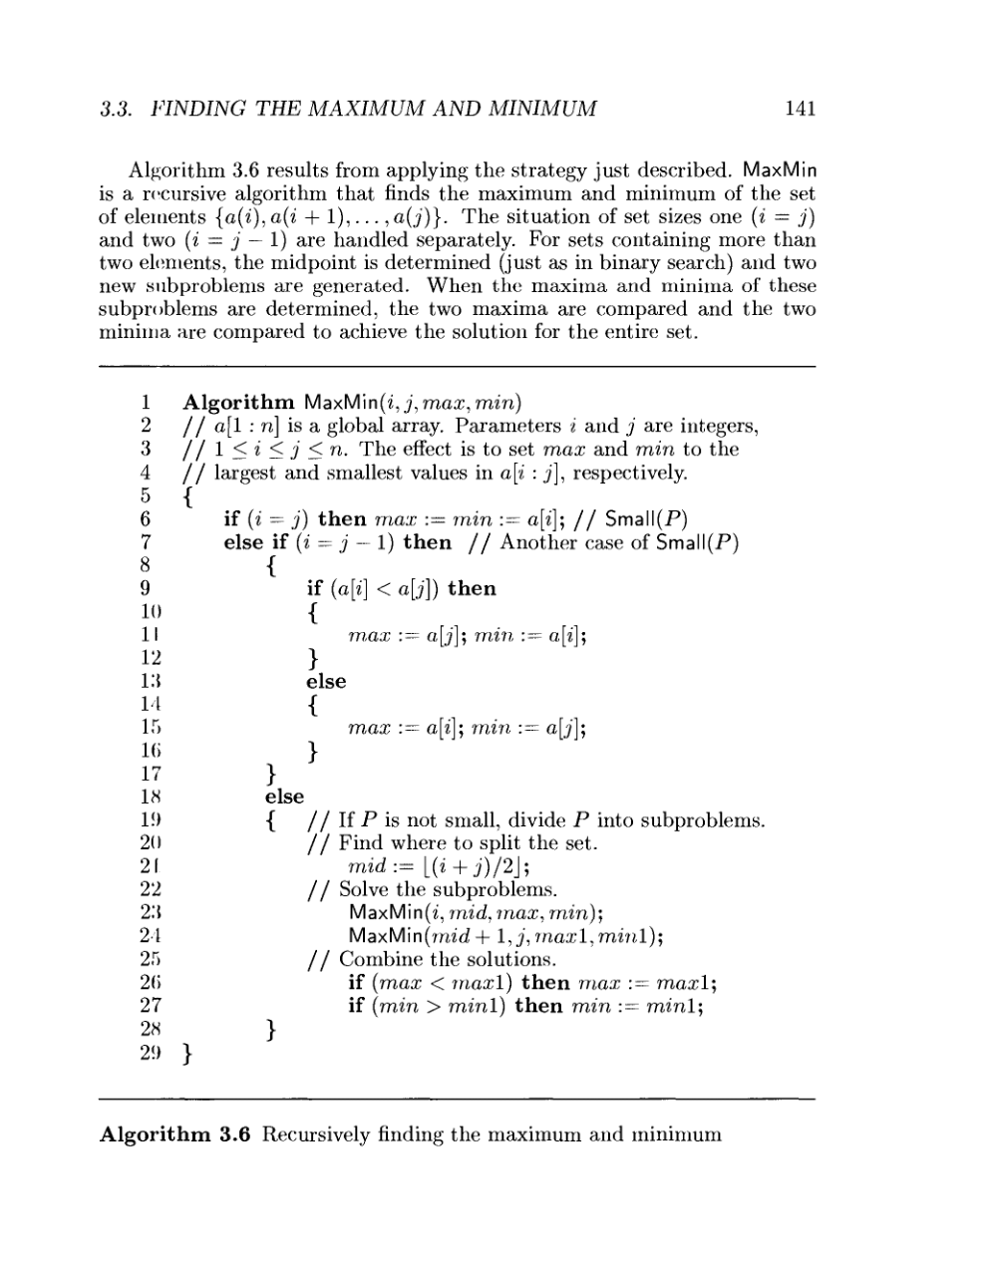
Max Min Problem: Divide and Conquer method: Algorithm

Slide 6
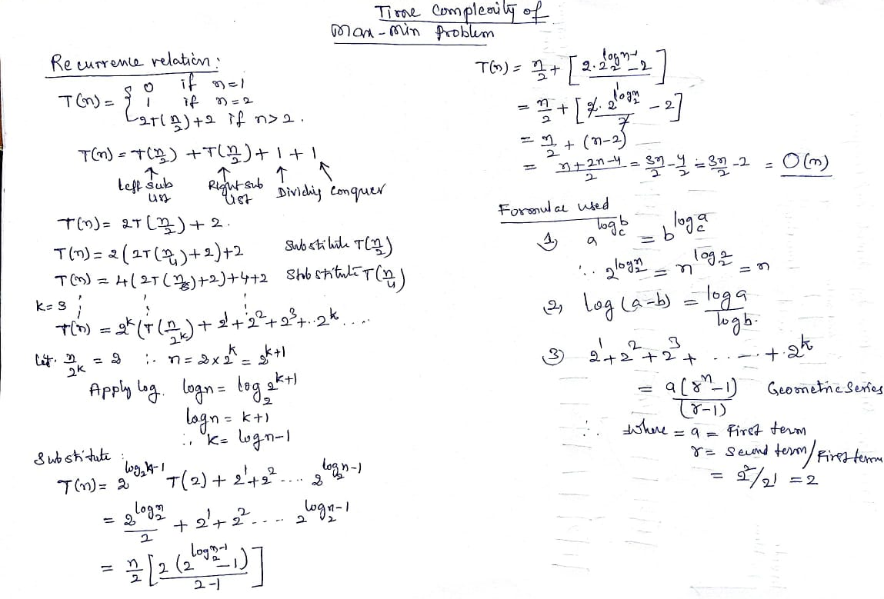
Max Min Problem: Divide and Conquer method: Algorithm Time Complexity

Slide 7
Comparison of Straight forward method and Divide and Conquer Method
Divide and Conquer the complexity 3n/2 – 2 is the best, average, worst case number of comparison when n is a power of two.
Comparisons with Straight Forward Method:
Compared with the 2n – 2 comparisons for the Straight Forward method, this is a saving of 25% in comparisons. It can be shown that no algorithm based on comparisons uses less than 3n/2 – 2 comparisons.
Ex: n=8
Straight forward method: 2*8-2=14 comparisons
Divide and Conquer method: 3*8/2-2= 10 comparisons

Slide 8
Topological sorting
Topological sort: An ordering of the tasks that conforms with the given dependencies

Slide 9
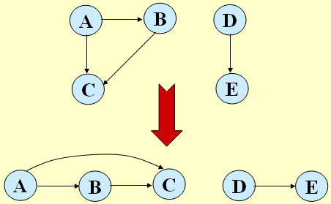
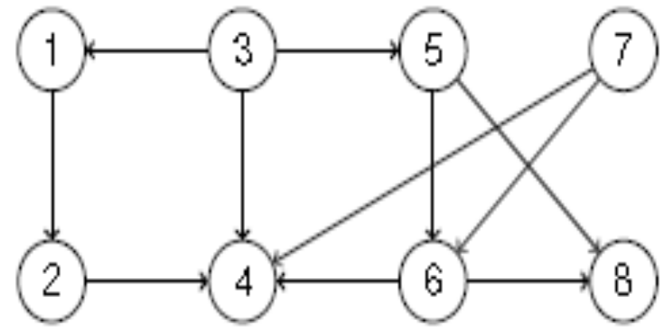
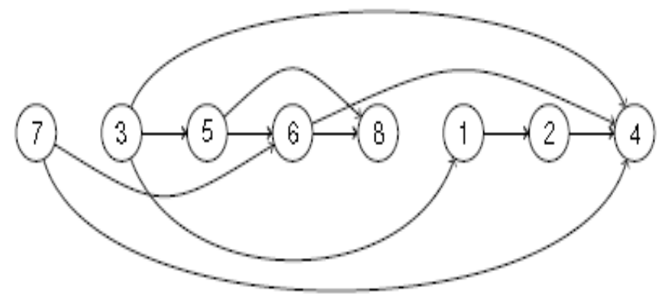
Definition of Topological Sort
Given a directed graph G = (V, E) a topological sort of G is an
ordering of V such that for any edge (u, v), u comes before v in
the ordering.
Example1:
Example2:

Slide 10
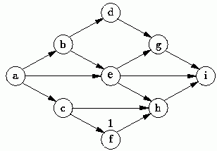
Topological Sort is not unique
Topological sort is not unique.
The following are all topological sort of the graph below:
s1 = {a, b, c, d, e, f, g, h, i}
s2 = {a, c, b, f, e, d, h, g, i}
s3 = {a, b, d, c, e, g, f, h, i}
s4 = {a, c, f, b, e, h, d, g, i}
etc.

Slide 11
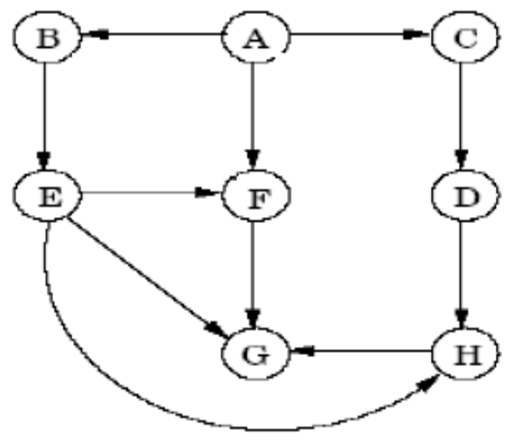
What is a DAG?
A directed acyclic graph (DAG) is a directed graph without cycles.
DAGs arise in modeling many problems that involve prerequisite constraints (construction projects, course prerequisites, document version control, compilers, etc.)
Some properties of DAGs:
  Every DAG must have at least one vertex with in-degree zero and at least one vertex with out-degree zero
    A vertex with in-degree zero is called a source vertex, a vertex with out-degree zero is called a sink vertex.
  G is a DAG iff each vertex in G is in its own strongly connected component
  Every edge (v, w) in a DAG G has finishingTime[w] < finishingTime[v] in a DFS traversal of G
Example:

Slide 12
Applications of topological sorting
A common application of topological sorting is in scheduling a sequence of jobs.
•The jobs are represented by vertices, and there is an edge from x to y if job x must be completed before job y can be started
•For example, in constructing a building, the basement must be completed before the first floor, which must be completed before the second floor and so on.
•A topological sort gives an order in which we should perform the jobs.

Slide 13
Methods of topological sorting
Source Removal Method
2. Depth First Search Method

Slide 14

Topological sort: Source Removal Method

Slide 15
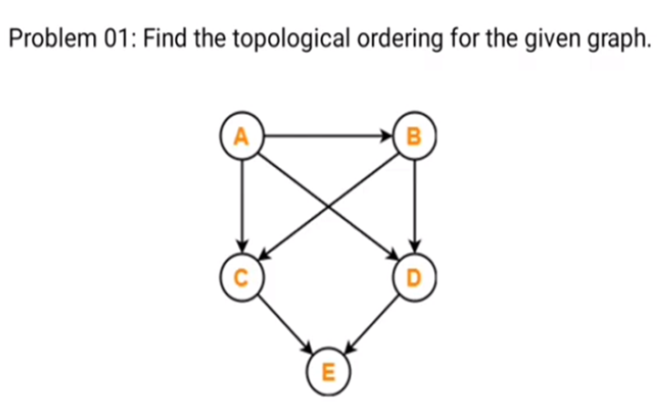
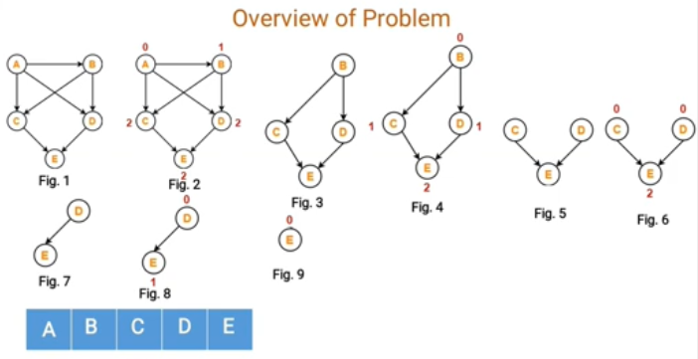
Example: Topological sorting using Source removal method

Slide 16
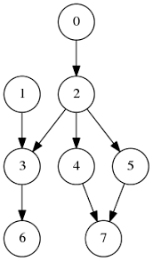

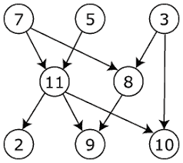
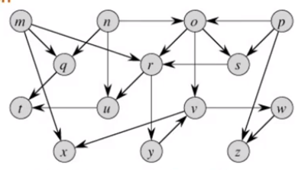
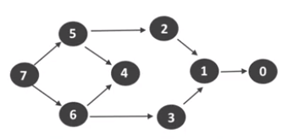
Exercise problems

Slide 17
Topological sorting: DFS Method- concepts
Edge (u,v) of G is classified as a:
(1) Tree edge iff u discovers v during the DFS: P[v] = u
If (u,v) is NOT a tree edge then it is a:
(2) Forward edge iff u is an ancestor of v in the DFS tree
(3) Back edge iff u is a descendant of v in the DFS tree
(4) Cross edge iff u is neither an ancestor nor a descendant of v
Can there be a back edge in a DFS on a DAG?
NO! Back edges close a cycle!
A graph G is a DAG <=> there is no back edge classified by DFS(G)

Slide 18
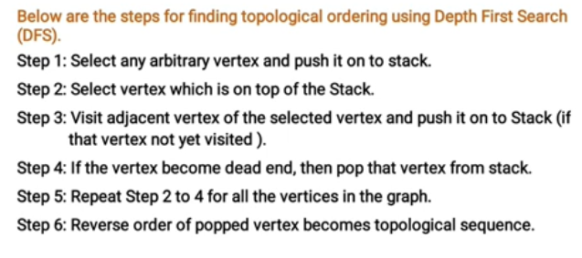
Topological sort: DFS Method

Slide 19
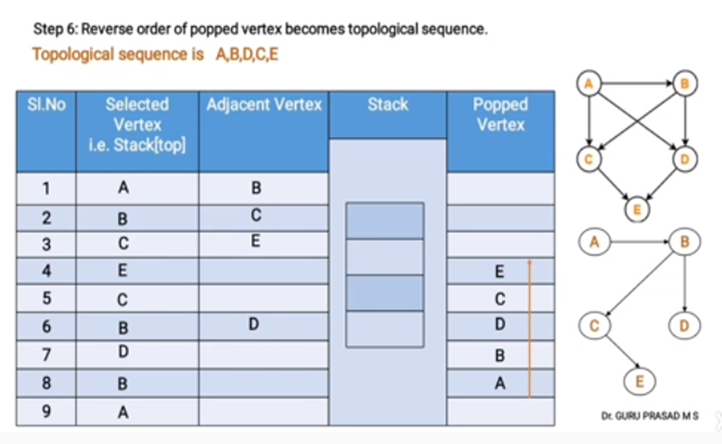
Topological sort: DFS Method

Slide 20
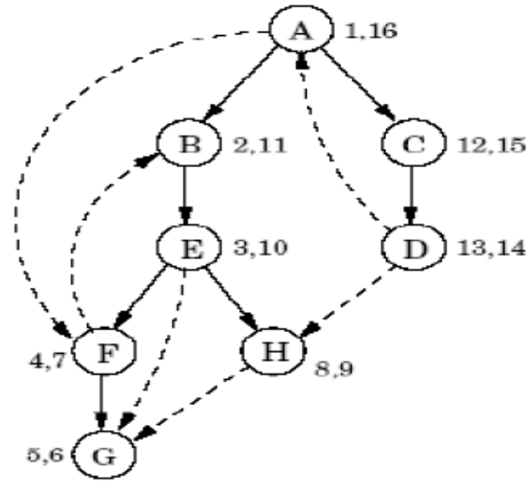

Topological Sorting: DFS based algorithm
Topological-Sort(G)
{
  1. Call dfs All Vertices on G to compute f[v] for each vertex v
  2. If G contains a back edge (v, w) (i.e., if f[w] > f[v]) , report error ;
  3. else, as each vertex is finished prepend it to a list; // or push in stack
  4. Return the list; // list is a valid topological sort
}
Running time is O(V+E), which is the running time for DFS.
Topological order: A C D B E H F G

Slide 21
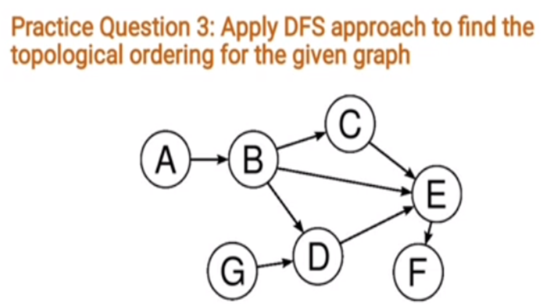
Example
Topological sorted : G
ABDCEF
Top of Stack | Adjacent | Stack | Pop
A | B | A
B | C | AB
C | E | ABC
E | F | ABCE
F | --- | ABCEF | F
E C B D B A G | ---- --- D ---- __ --- -- | ABCE ABC ABD AB AB A G | E C --- D B A G

Slide 22
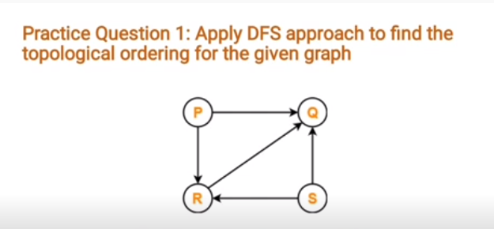
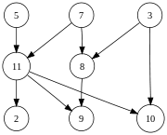
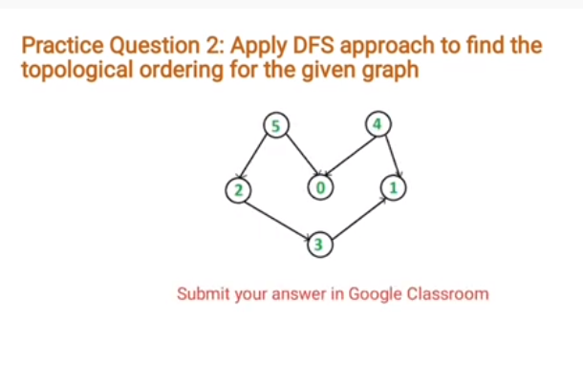

Exercise problems

Slide 23
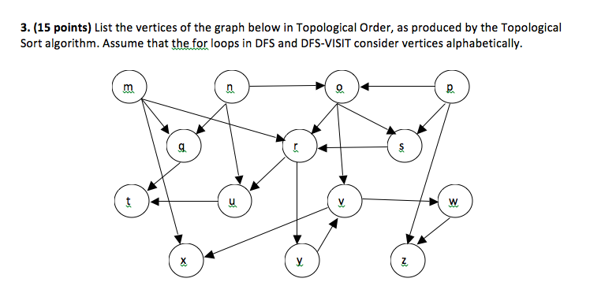
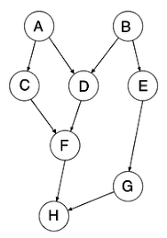
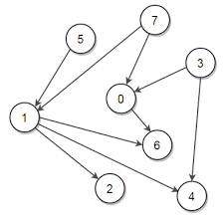
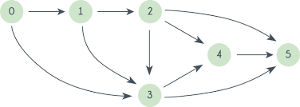
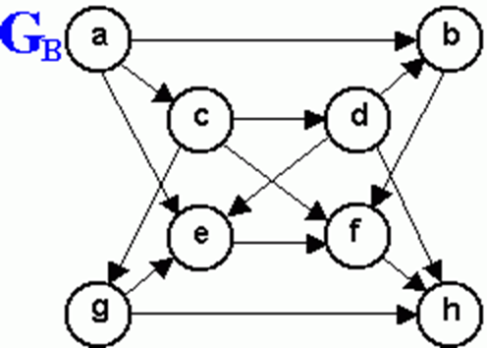
Problems

Slide 24
Proof of correctness
Theorem: TOPOLOGICAL-SORT(G) produces a topological sort of a DAG G
The TOPOLOGICAL-SORT(G) algorithm does a DFS on the DAG G, and it lists the nodes of G in order of decreasing finish times f[]
We must show that this list satisfies the topological sort property, namely, that for every edge (u,v) of G, u appears before v in the list
Claim: For every edge (u,v) of G: f[v] < f[u] in DFS

Slide 25
Proof of correctness
“For every edge (u,v) of G, f[v] < f[u] in this DFS”
The DFS classifies (u,v) as a tree edge, a forward edge or a cross-edge (it cannot be a back-edge since G has no cycles):
  If (u,v) is a tree or a forward edge ⇒ v is a descendant of u ⇒ f[v] < f[u]
  If (u,v) is a cross-edge

Slide 26
Proof of correctness
“For every edge (u,v) of G: f[v] < f[u] in this DFS”
  If (u,v) is a cross-edge:
as (u,v) is a cross-edge, by definition, neither u is a descendant of v nor v is a descendant of u:
  d[u] < f[u] < d[v] < f[v]
  or
  d[v] < f[v] < d[u] < f[u]
Q.E.D. of Claim
since (u,v) is an edge, v is surely discovered before u's exploration completes
f[v] < f[u]

Slide 27
Proof of correctness
TOPOLOGICAL-SORT(G) lists the nodes of G from highest to lowest finishing times
By the Claim, for every edge (u,v) of G:
f[v] < f[u]
⇒ u will be before v in the algorithm's list
Q.E.D of Theorem

